Slide 1
ThunderGlide Motors Sales Analysis Project
Team Lead
Amal Mohamed Abdelrazek Nawar

Slide 2
Famous for motorcycles, ThunderGlide Motors Sales Team is working on a project for the past two years 2003, 2004 and the first two quarters of 2005 to analyze key trends and insights with a focus on market preferences and future investment opportunities

Slide 3
Business Need
Key Finding
Value Proposition
Without clear insights into market trends and customer preferences, there was an increased risk of missing potential investment opportunities and failing to align product offerings with consumer demand.
By targeting specific regions with tailored marketing campaigns, ThunderGlide Motors can raise brand awareness, boost product visibility, and drive up sales for underperforming products.
With a deep dive into product performance by region, customized strategies to each market will enhance precision and impact, enabling us to make data-driven decisions that cater to regional preferences and demand."

Slide 4
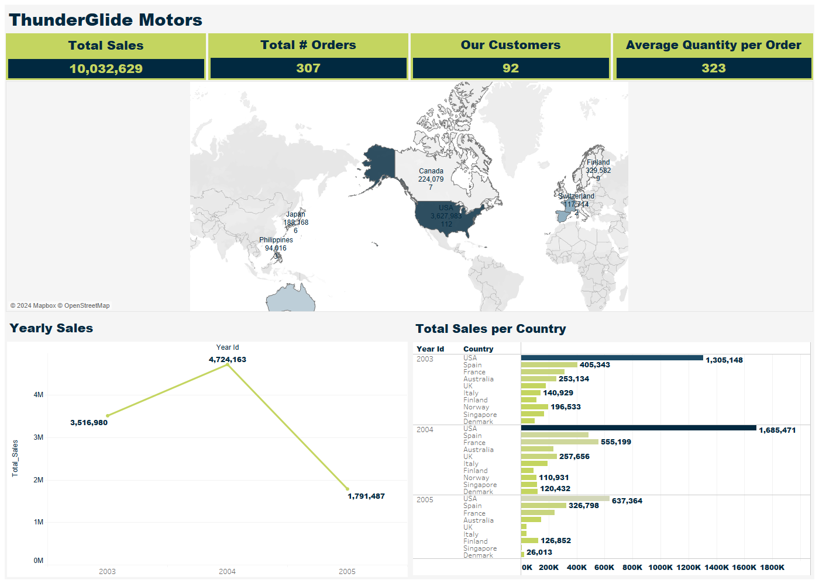

Slide 5
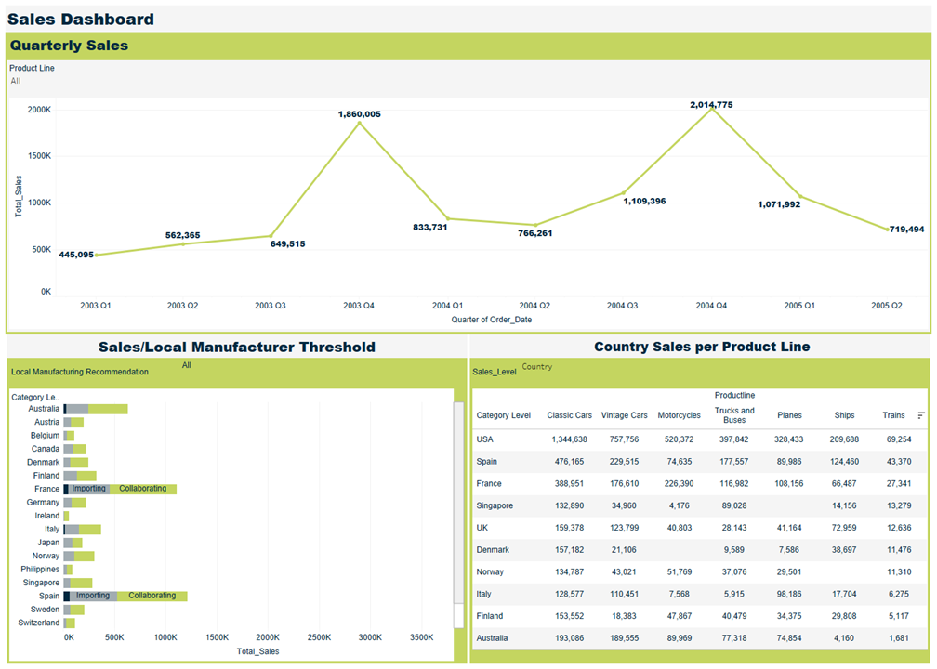

Slide 6
Key Insights
Total Sales for the Last 3 years is 10,032,629 $
Daily Sales Average is 3554 $
93.2% of the orders were shipped successfully
Average quantity requested per order is 323 item.
Classic Cars and Vintage Cars are our best seller product lines with 39.07% and 18.97% contribution to the total sales, and Motorcycles come in the third place.
Sales peak at small and medium deal sizes.

Slide 7
Key Insights
Most of our customers especially those in the EMEA territory prefer Medium and small Deal sizes to large Deal size.
The EMEA territory, which has more countries than other territories has the highest number of sales but individually, the sales from USA dwarfs every other country and Spain comes in the second place.
Sales rise at the third and fourth quarters in the first two years.
The Highest Motorcycle sales were in the last quarter of 2004
USA and Spain are the highest consumer of cars of our top ten customer countries
Average Annual Sales for motorcycles are 465,800 $

Slide 8

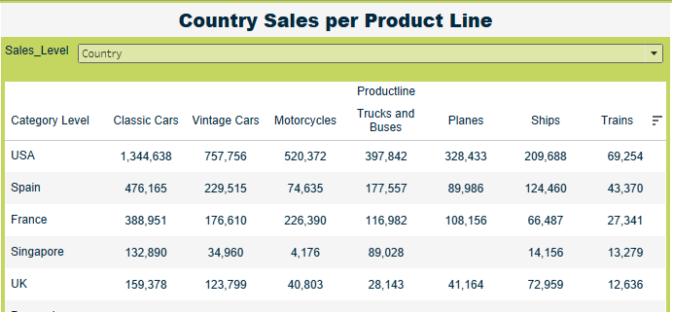
By analyzing product line sales across different levels (country, city, and region), this project ensures precise, market-specific insights that strengthen upcoming sales strategies for each target segment.

Slide 9
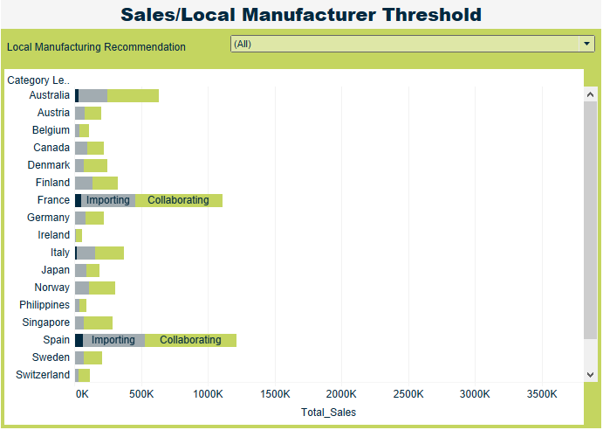
Based on the Manufacturer Selling Recommended Price data, the sales team recommends partnering with existing manufacturers rather than investing in building new local facilities.

Slide 10
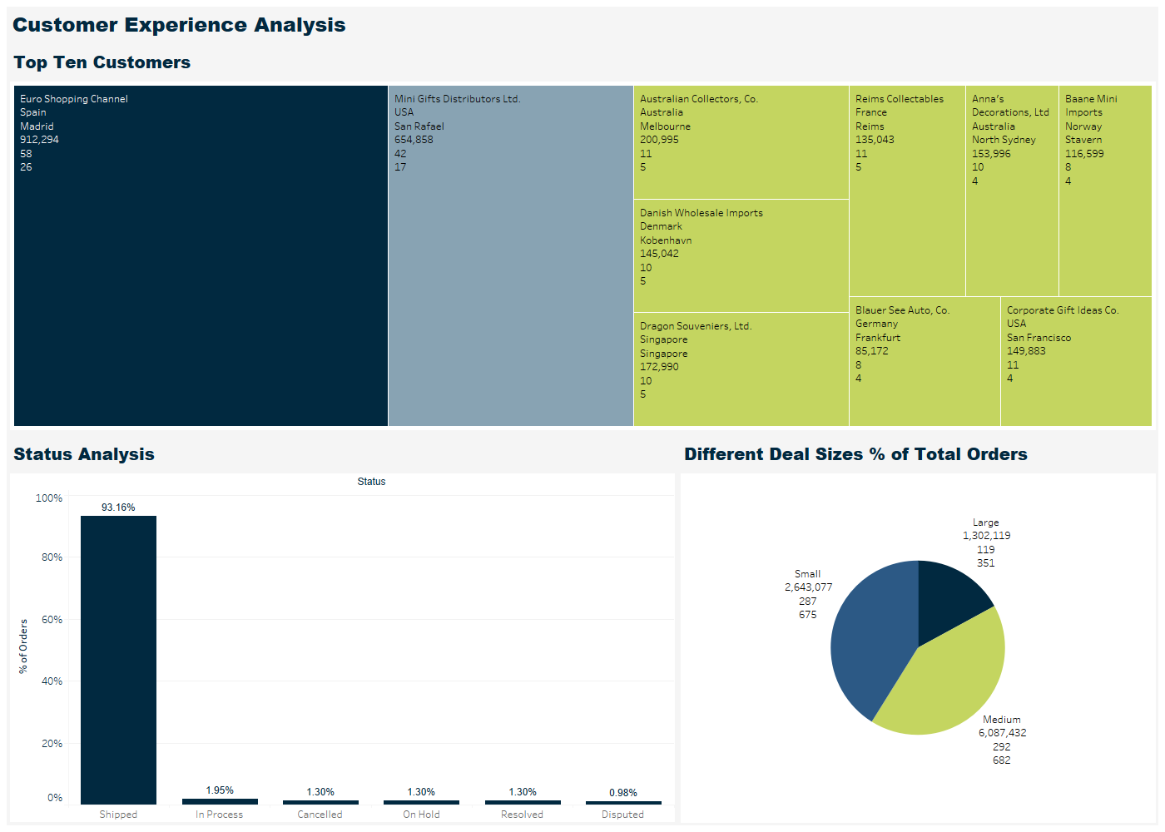

Slide 11
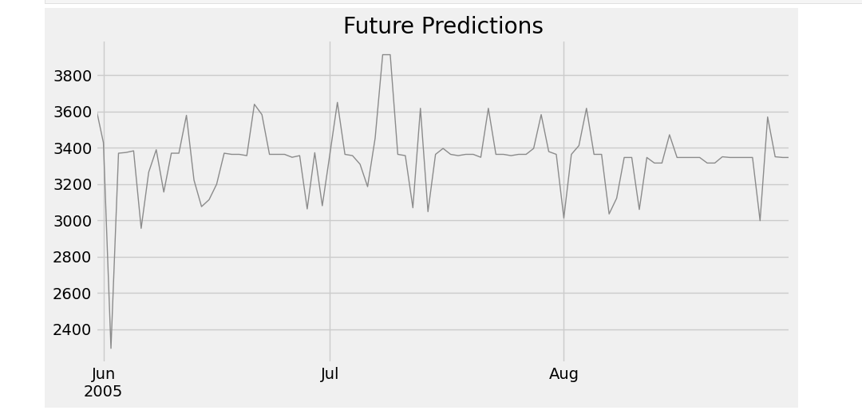
Using time series forecasting with XGBoost to predict the next 3 months of sales, Our goal is to project future sales trends.

Slide 12
Recommendations
Increase promotional activities for underperforming products in specific regions.
Strengthen inventory management for products in high demand during seasonal spikes.
Local Manufacturer construction is recommended for countries’ sales exceeding 150,000 dollars.
Use advanced predictive models to optimize stock levels and ensure product availability during peak times.

Slide 13
First Step Dataset was extracted from the company’s sales database for the past three years. Second Step Data cleaning and preprocessing was conducted using python and pandas. Incomplete and null sales data was resolved through careful data cleaning and validation processes. Delivered: 30/9/2024 Third Step Data initial exploration was conducted using Microsoft SQL Server. Delivered: 10/10/2024 Fourth Step Deep – dive data analysis and sales forecasting was performed using time-series models, leveraging historical data to project future trends. The analysis focused on customer segmentation, product performance, and regional sales patterns. Delivered: 19/10/2024 Fifth Step Data Visualization was conducted using Tableau using SQL Server data source. Delivered: 20/10/2024

Slide 14
Data Structure Shape of Data The dataset consists of 2,823 and 18 columns. Temporal Data The order date, Month_ID, Qtr_ID, and Year_ID features enable time-based analysis of sales performance and trends. Quantity Ordered: the quantity ordered for each product Price Each: Price Per Product Sales: Quantity Multiply the Product Price Status: Order Status MSRP: Manufacturer Selling Recommended Price Product Code: Represent The Id Identify for each Product Deal Size: How Big, Medium, Small The Deal Can Be Categorized.

Slide 15
Tools & Languages Used Data Extraction and Cleaning Python (Pandas, Numpy) Data Exploration and Analysis and Forecasting Python (Pandas, Numpy, Matplotlib, Scikit-learn), Microsoft SQL Server Data visualization Tableau

Slide 16
Amal Mohamed Mohamed Abdelrazek: Team Leader and Tableau Visualization Developer
Nour Elhuda Mahmoud : Data Initial Analysis and Exploration (SQL Script Developer)
Esraa Bahaa Abdelrahem:
Data Cleaning, Preprocessing and Governance, Reporting (Python Data Cleaning Script Developer).
Shymaa Ahmed: Business Questions Designer and SQL Queries Designer.
Aya Ibrahim Ramadan:
Deep-dive Data Analysis and Forecasting (Python Script Developer).
Salma Medhat Mohammed: UX Designer
Eslam Sleman Mohamed: UX Designer

Slide 17
Q&As

Slide 18
Thank You

